Slide 1
Harford County Health Department
The Health of Harford County
Russell Moy, MD, MPH, Health Officer
June 3, 2019

Slide 2
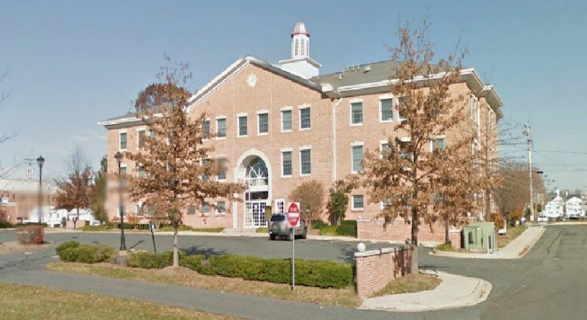
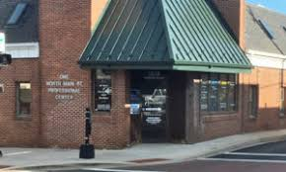
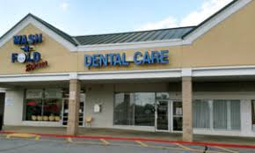
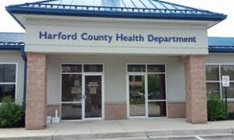
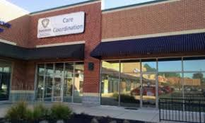
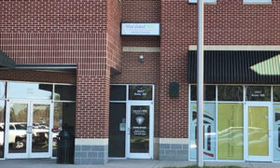
Health Department Locations
120 S. Hays St., Bel Air
1 N. Main St., Bel Air
2204 Hanson Rd., Edgewood
1321 Woodbridge Station Way, Edgewood
2015 Pulaski Hwy,
Havre de Grace
2027 Pulaski Hwy,
Havre de Grace

Slide 3
Mission To protect, promote, and improve the health, safety, and environment of Harford County residents. Vision To make Harford County the healthiest community in Maryland. Values Teamwork, Leadership, Collaboration, Integrity, Commitment, Cultural Sensitivity
Harford County Health Department (HCHD)
Mission, Vision, and Values

Slide 4
HCHD Services
Addictions services
Health planning
AERS services
HIV / STI treatment
Birth certificates
Homevisiting
Cancer prevention
Immunizations
Care Coordination Plus
MD health insurance
Communicable disease
Mental health
Dental care
Outbreak investigation
Emergency response
Population health
Environmental health
Tobacco cessation
Family planning
Transportation
Health education
WIC nutrition

Slide 5
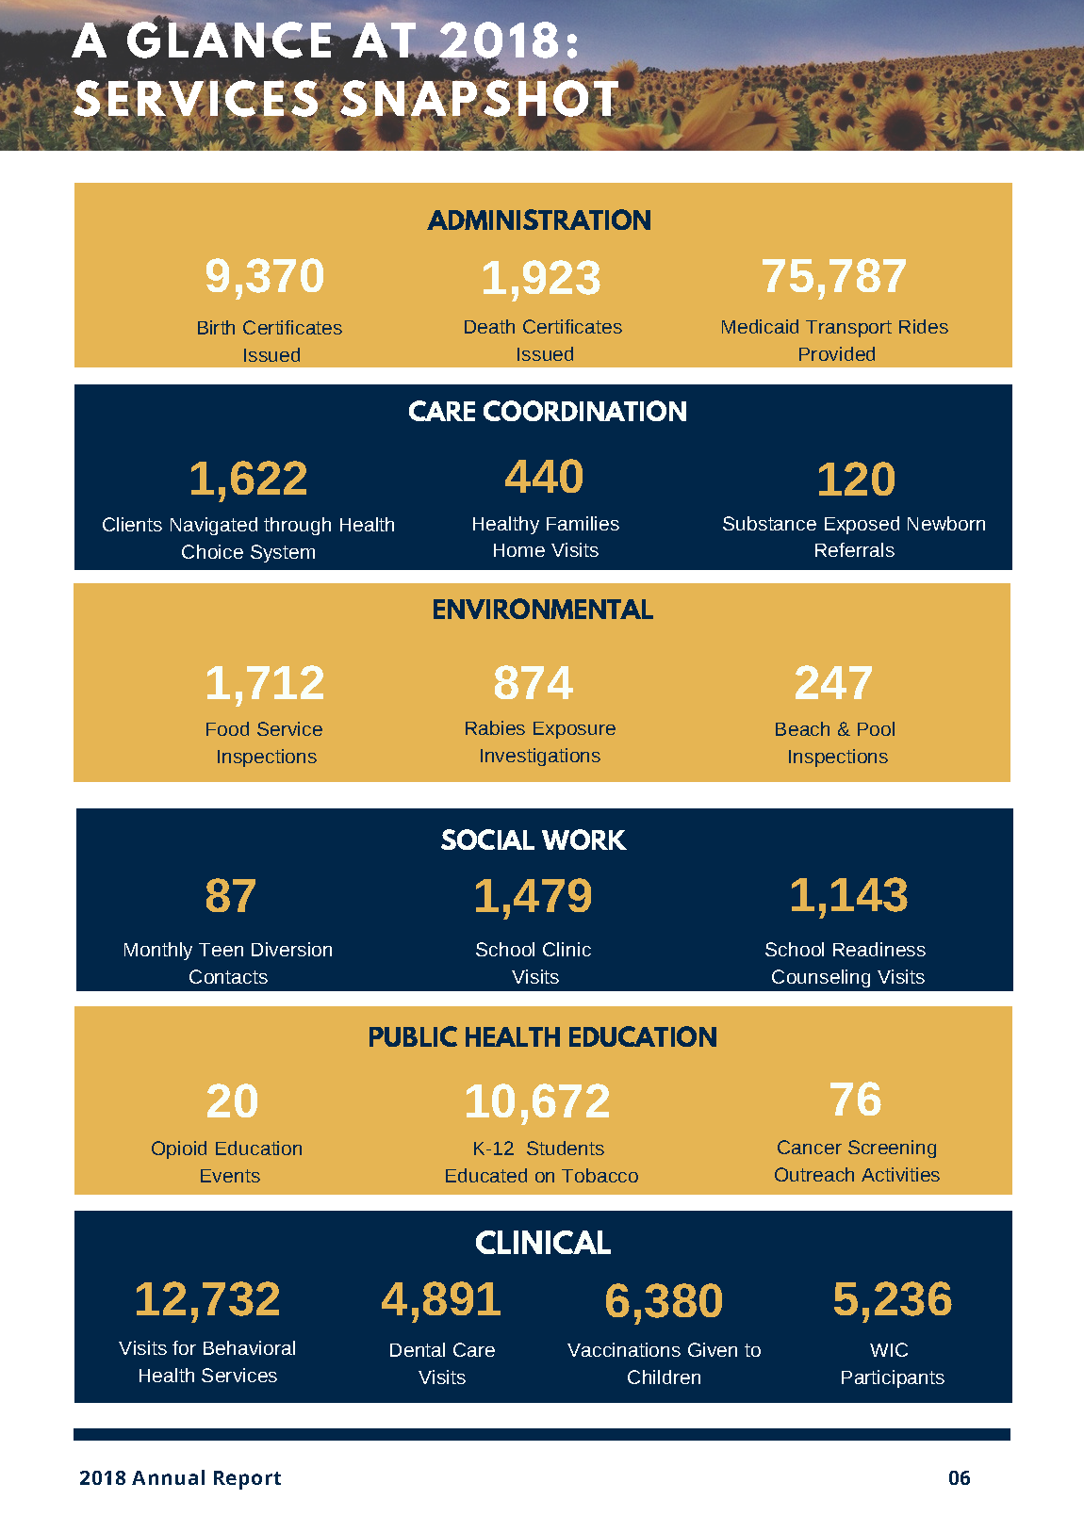

Slide 6
Shared Local Public Health Governance
Maryland Department of
Health (MDH)
Robert Neall, Secretary
Fran Phillips, Deputy Secretary
Harford County Council
(Ex Officio Board of Health)
Patrick Vincenti - Council President
Andre Johnson, Joseph Woods,
Tony Giangiordano, Chad Shrodes
Robert Wagner, Curtis Beulah
Maryland Department of
Environment (MDE)
Harford County Health Department
Russell Moy, MD, MPH, Health Officer
Marcy Austin, Deputy Health Officer
Administrative
Services
Environmental Health
Family
Health
Behavioral Health
Clinical
Health
Care
Coordination

Slide 7
How healthy are Harford County residents?
Of Maryland’s 24 jurisdictions, what is Harford County’s 2019 health ranking?
(A) # 1 (most healthy)
(B) # 7
(C) # 10
(D) # 16
(E) # 24 (least healthy)

Slide 8
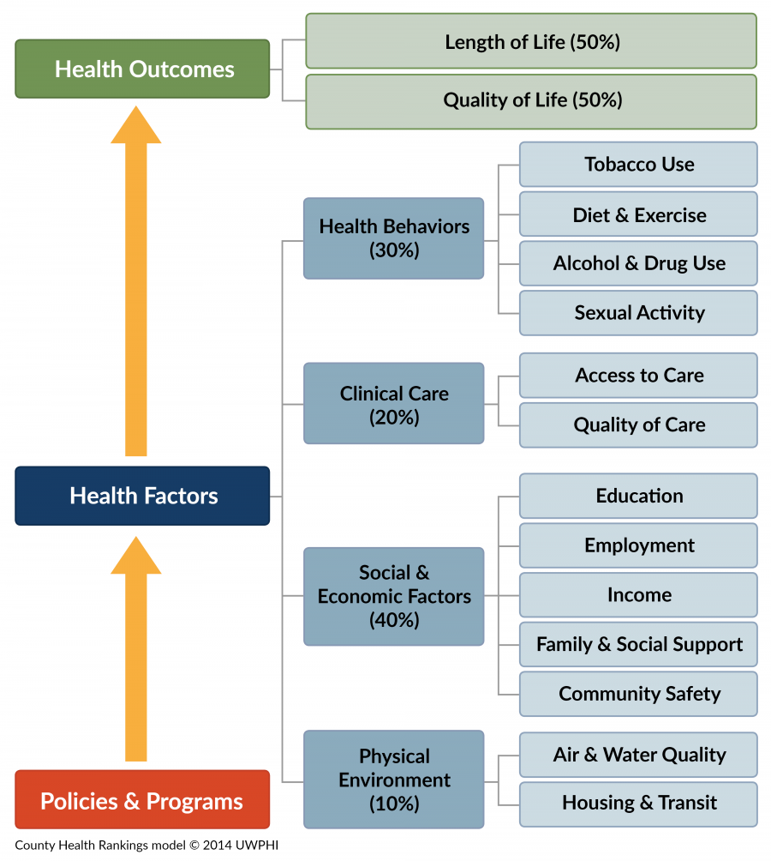
RWJF’s County Health Rankings Methodology
HEALTH FACTORS
Health Behaviors 30%
Clinical Care 20%
Socio-Economic 40%
Physical Environment 10%

Slide 9
2019 County Health Rankings:
By Maryland Jurisdiction

Slide 10
Health Indicators | Harford County | Maryland | Top U.S. Performers
HARFORD COUNTY DOING BETTER
Infant mortality (per 1k) | 4 | 7 | 4
Teen births (per 1k) | 11 | 19 | 14
Uninsured (%) | 5 | 7 | 6
HARFORD COUNTY DOING WORSE
Drug overdose deaths (per 100k) | 34 | 31 | 10
Adult smoking (%) | 15 | 14 | 14
Adult obesity (%) | 30 | 30 | 26
Poor mental health days | 3.6 | 3.5 | 3.0
Source: RWJF County Health Rankings 2019

Slide 11
Impact of the Overdose Crisis

Slide 12
Drug & Alcohol Intoxication Deaths By place of occurrence, Harford County, 2013-2017*
180% increase over the past 5 years

Slide 13
Opioid-Related Overdose Deaths
Harford County, 2009-2018*
Harford rate down 3.2%, while MD rate up 5.2% over the past 1 year.

Slide 14
Harford County has the 9th worst death rate for opioid overdose deaths in Maryland.

Slide 15
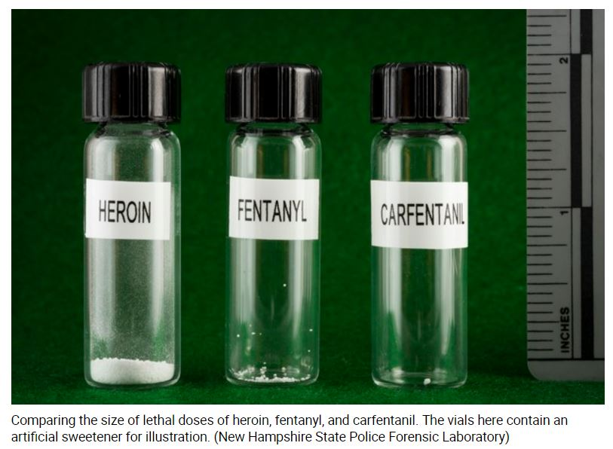
Fentanyl is the primary overdose killer

Slide 16
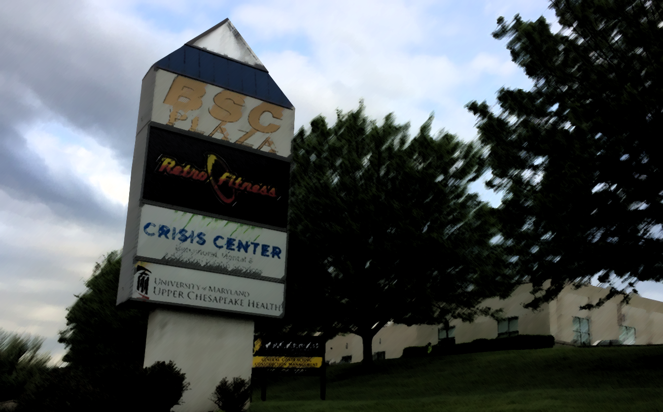
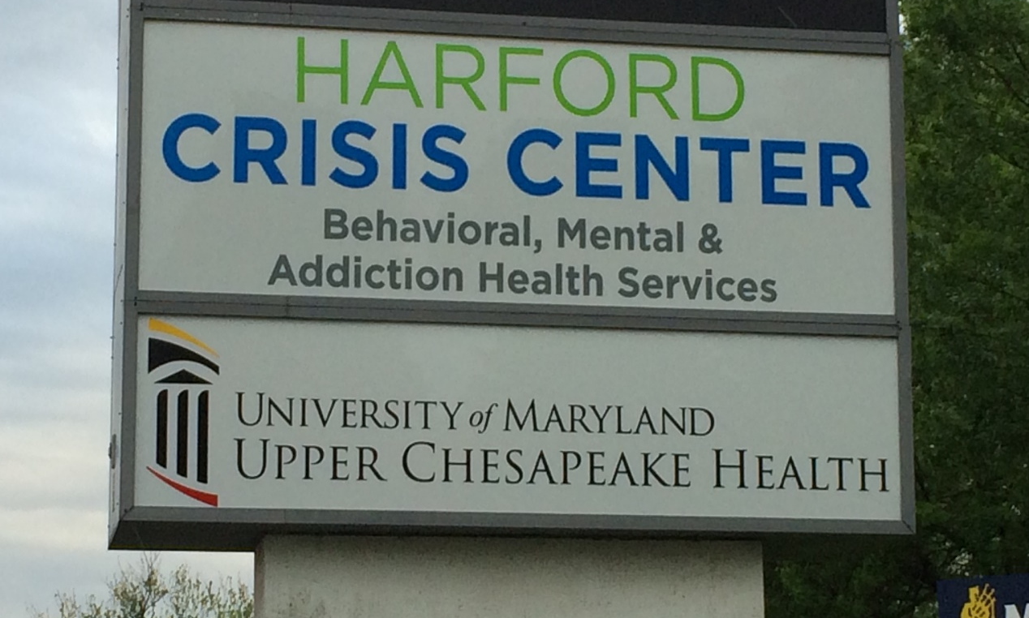
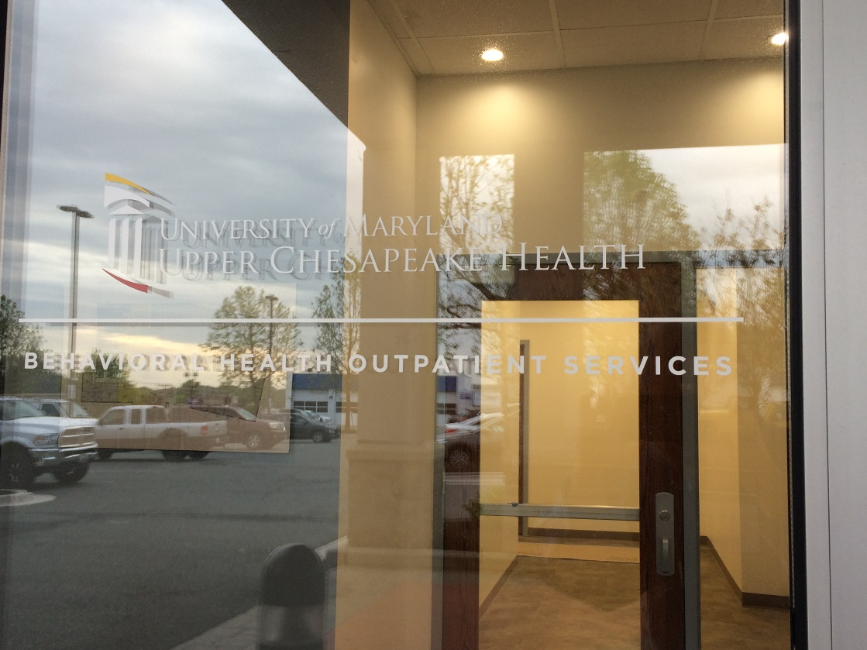
Harford Crisis Center – Phase 2 Opening June 2019
410-874-0711 – 1-800-NEXT-STEP

Slide 17
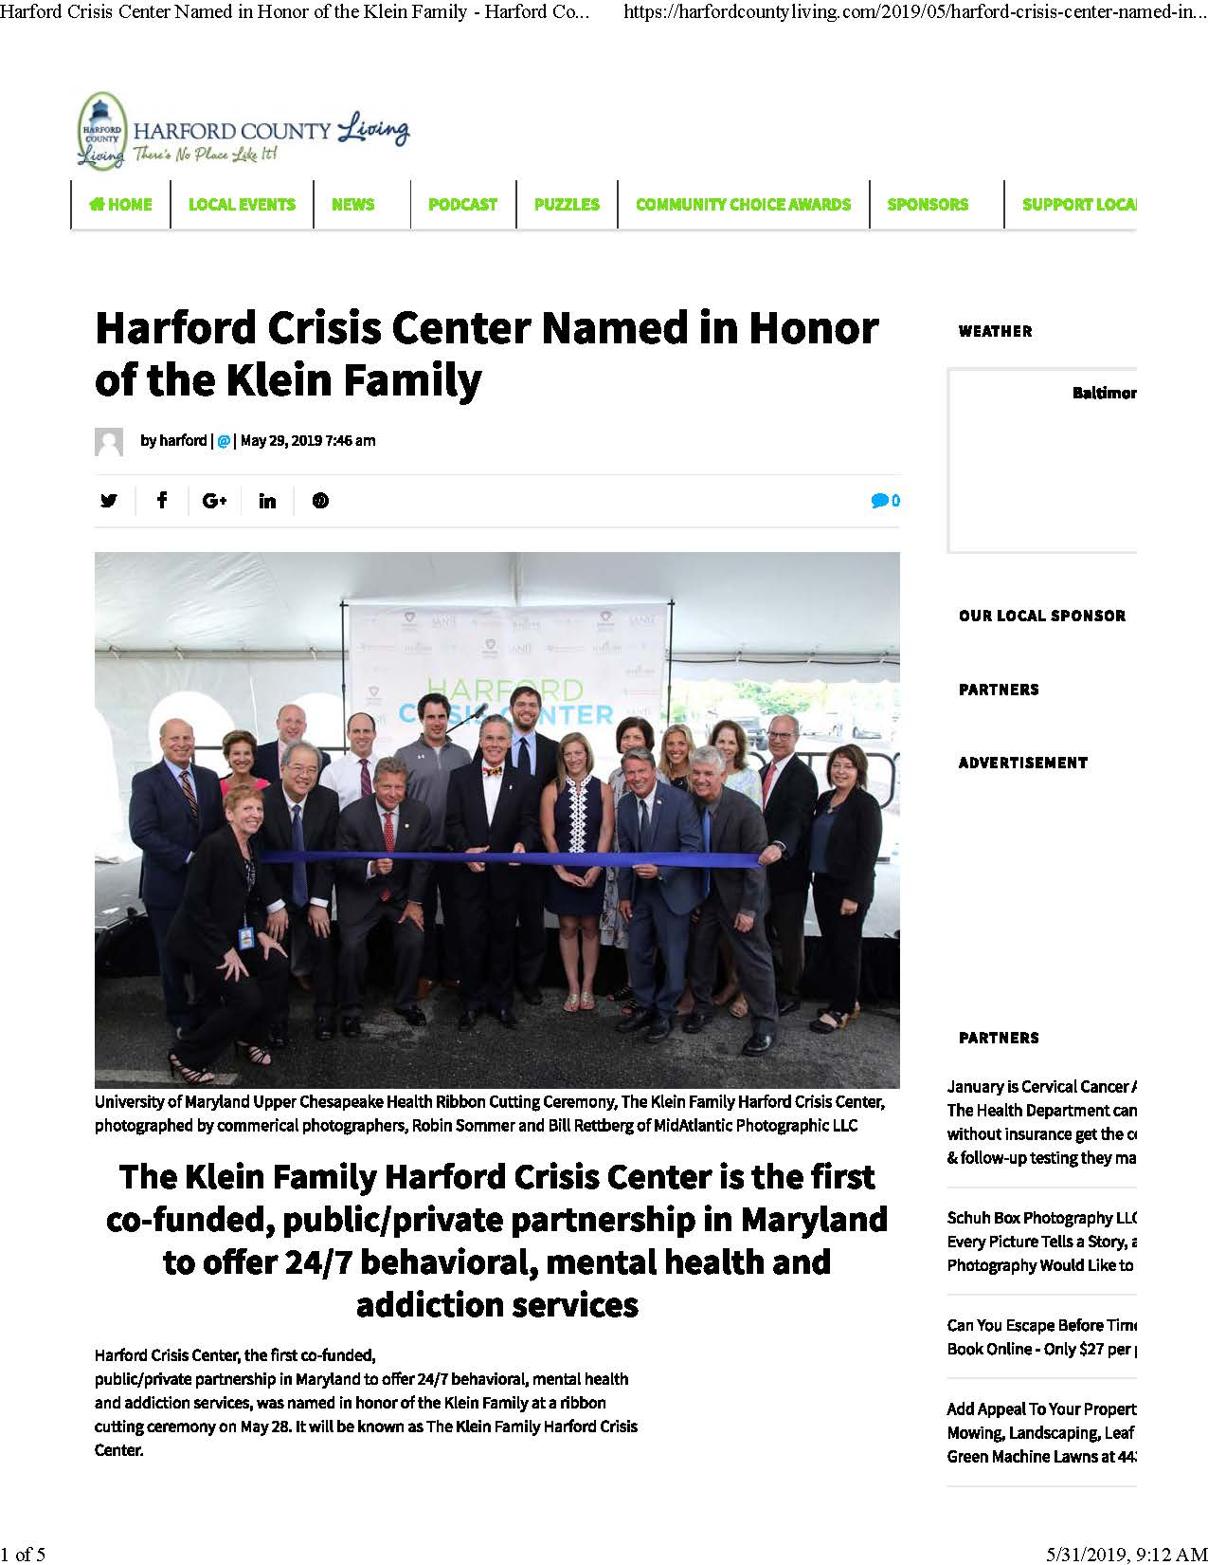

Slide 18
Why Do We Need a Behavioral Health Crisis Center?
MY LOVED ONE NEEDS HELP NOW
IS THIS AN EMERGENCY?
YES
NOT SURE OR NO
CALL 911
Call 24/7 Harford Crisis Center
410-874-0711 or 1-800-NEXT-STEP
-Crisis worker will ask questions and talk you through the situation.
-If needed, a Mobile Crisis Worker will meet you where you are.
-If needed, you can come in to the Walk-In Center 24/7 for help.
-If needed, you can stay for stabilization services and observation.
-If needed, you may be admitted to a short-term residential bed.
-If needed, you may access on-site MH or SUD outpatient services.

Slide 19
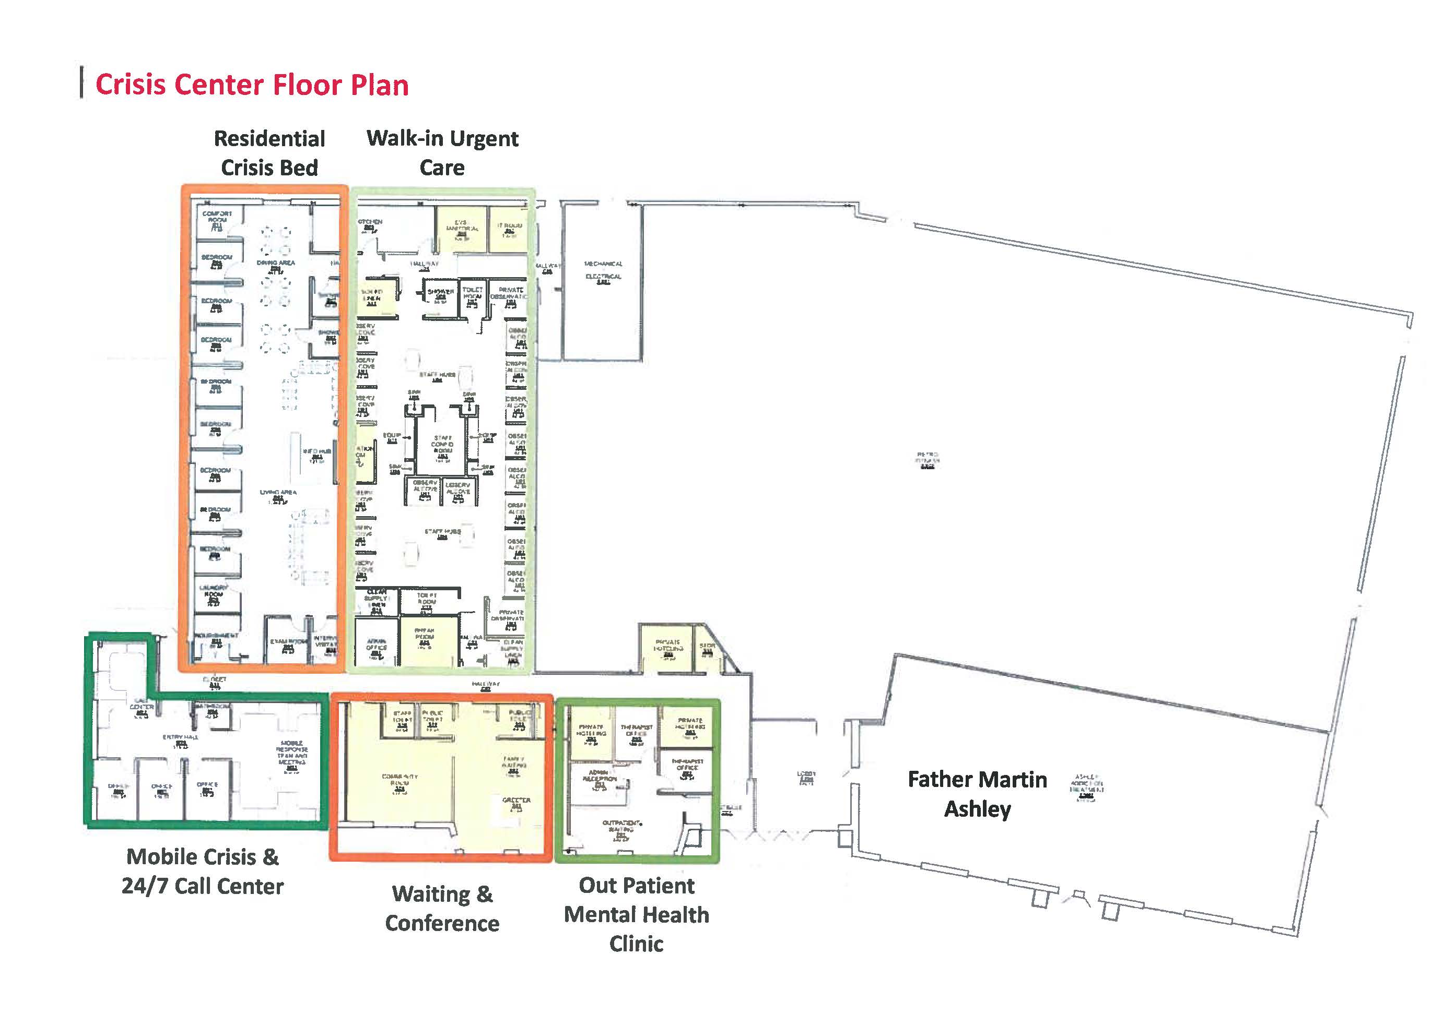
410-874-0711
802 Baltimore Pike, Bel Air, MD 21014
Out Patient Substance Use Treatment Clinic
FRONT DOOR

Slide 20
Substance Exposed Newborn (SEN) Rates Harford County & Maryland, 2000-2017
Harford County rates increased by 185% over the past 10 years.
NOTE: ICD 9 Codes used 760.70, 760.71. 760.72, 760.73, 760.75, 760.77, 779.5
ICD 10 Codes used P04.3, P04.4, P04.41, P04.49, P04.8, P04.9, P96.1
* 2017 DATA IS PRELIMINARY – Data compiled by MCHB/MDH. Chart prepared by HCHD.
Source: HSCRC Hospital Data, 2000-17, Maryland resident births only, does not include Maryland resident births born out of state.

Slide 21
Rate of Neonatal Abstinence Syndrome (NAS) births, by jurisdiction of residence, Maryland, 2008-2017
80
70
60
50
40
30
20
10
0
72.9
Number NAS per 1,000 newborns
63.1
44.8 _{41.7}
^{22.1 21.9 19.6} 19.2 19.2 18.9 18.4 18.3 18.2 18.1 17.7 17.6
17.0 _{13.4 12.4 11.5 10.9}
5.4
1.6 1.4
2008-2012 2013-2017*
Source: Health Services Cost Review Commission (HSCRC). Data reflect Maryland newborn residents in Maryland hospitals only. NAS based on a diagnosis
of the following on the newborn discharge record: ICD-9 779.5: drug withdrawal syndrome in newborn, or ICD-10 P96.1: neonatal withdrawal symptoms from maternal use of drugs of addiction.
*Changes in NAS coding from ICD-9 to ICD-10 in October 2015 may have influenced the number of NAS newborns in these years Data suppressed for jurisdictions with less than 11 NAS newborns. ^Rates for 2008-2012 and 2013-2017 differ significantly (p<0.05)

Slide 22
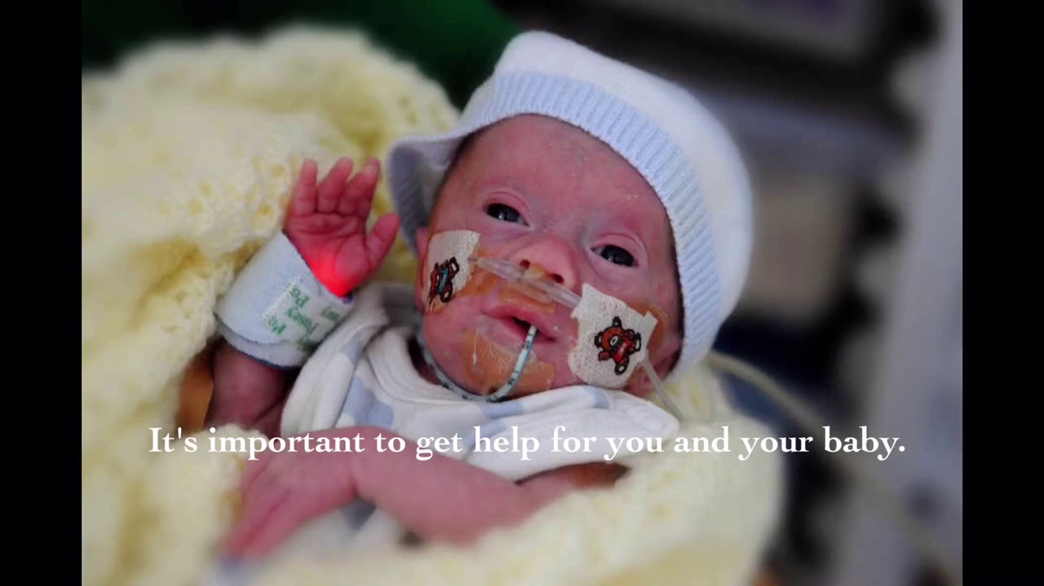
Why do some SEN babies develop NAS and others don’t? How can mothers be supported?
SEN≠NAS. It’s a complex picture. NAS is a lot more than opioid exposure.
Smoking cessation. Focus on the modifiable behaviors, in particular, smoking cessation. At least 80% of women with opioid use disorder smoke cigarettes. It’s a great opportunity to talk about smoking cessation, even cutting back cigarettes is beneficial.
Breastfeeding. It’s also a great opportunity to talk about breastfeeding and skin-to-skin contact: holding the baby, rooming in if possible, and breastfeeding as ways to reduce the severity and duration of NAS.
Continuity of care – through WIC, care coordination, women’s health, and behavioral health services.
From: ACOG Update, Volume 43, Edition 5

Slide 24
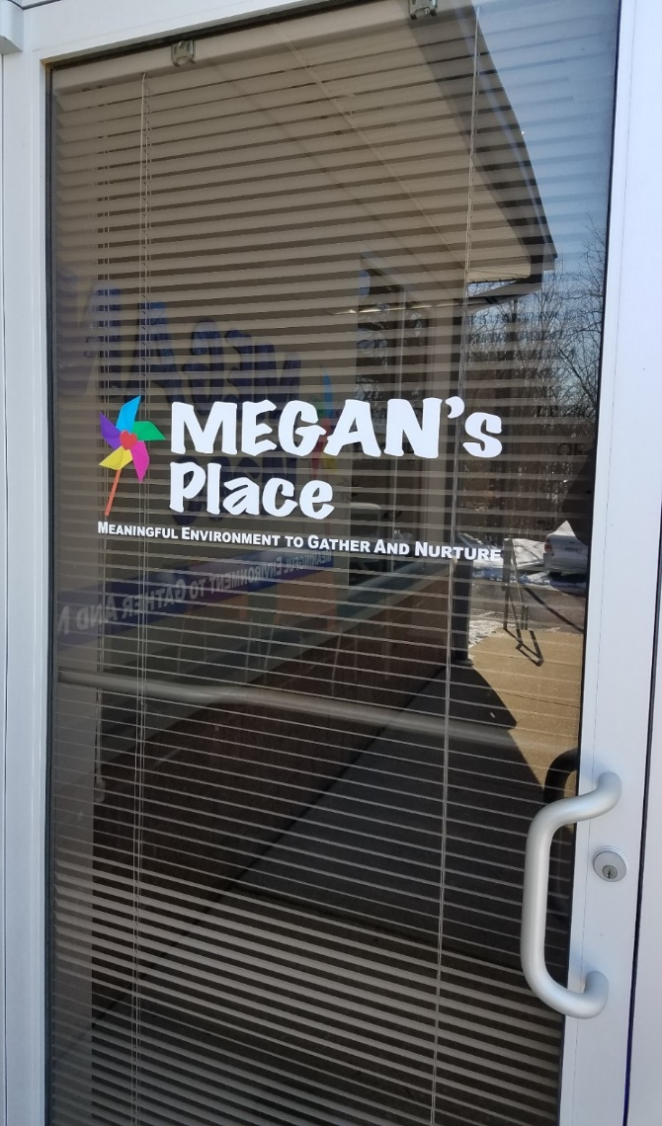
MEGAN’s Place:
Meaningful Environment to Gather and Nurture
What is MEGAN’s Place?
A safe, non-judgmental place for at-risk pregnant and postpartum women and their families who need assistance – with information/guidance, resources/services, and care coordination/support – in Harford County.
A supportive and restorative place for building family resilience.
Evidence-based practices:
Helping Families Recover peer support and wraparound services
Healthy Families America model of home visiting and
care coordination
3

Slide 25
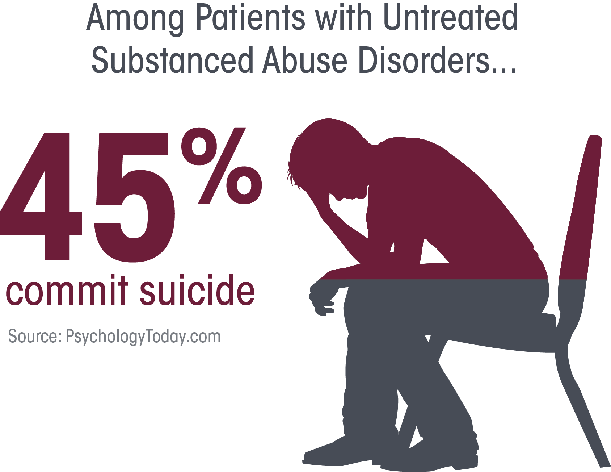
Relationship between untreated substance abuse disorders and suicide
Attempt suicide, according to one study

Slide 26
Suicide Mortality Rates Harford County & Maryland, 2013-2017
* Age-Adjusted Rates
Source: Maryland Vital Statistics Reports

Slide 27
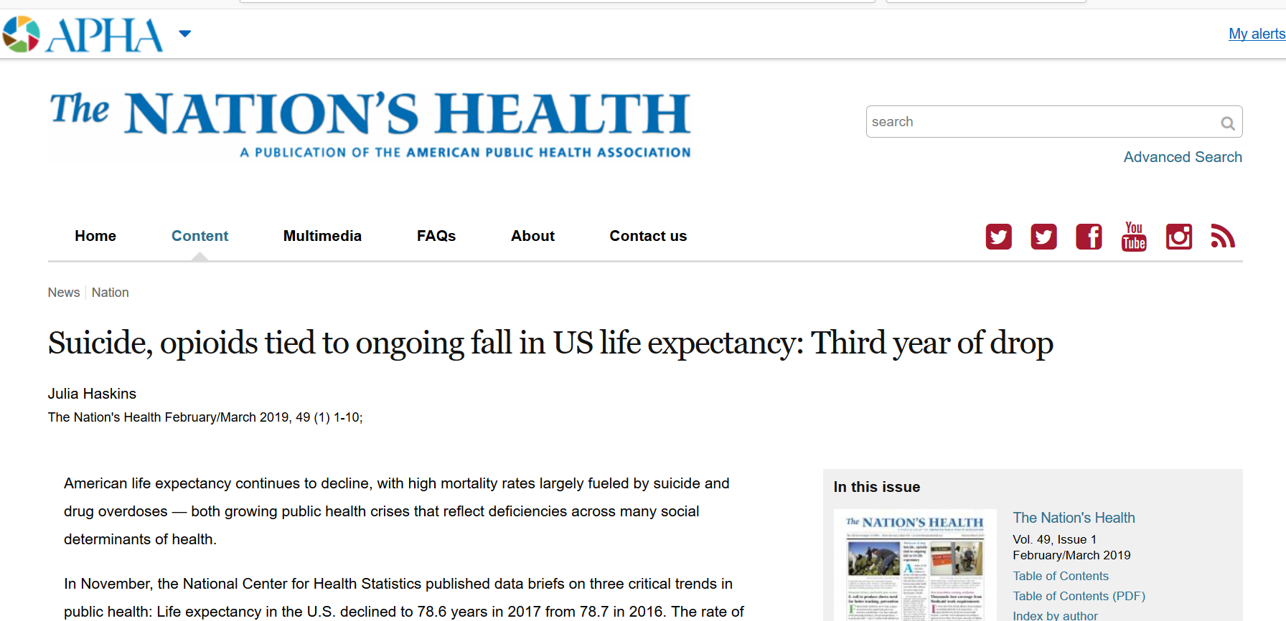
U.S. Life Expectancy Has Declined
for 3 Years in a Row
3

Slide 28
What is the average life expectancy of a Harford County resident?
84.9 years
79.5 years
79.4 years
76.8 years
73.4 years

Slide 29
What is the average life expectancy of a Harford County resident?
84.9 years – Montgomery County
79.5 years – Maryland State average
79.4 years – Harford County
74.7 years – Cecil County
73.4 years – Baltimore City
Location – Location - Location
There’s an 11.5 year geographic disparity in average life expectancy within Maryland.
Source: Maryland Vital Statistics, 2016

Slide 30
Which Harford County zip code area has the highest average life expectancy?
Edgewood
Aberdeen
Havre de Grace
Joppa
Bel Air

Slide 31
Which Harford County zip code area has the highest average life expectancy?
Edgewood – 74.7 years
Aberdeen – 75.5 years
Havre de Grace – 76.6 years
Joppa – 78.5 years
Bel Air – 81.5 years
Source: www.rwjf.org

Slide 32
Average Life Expectancy
By Harford County Zip Codes, 2016
Source: www.rwjf.org

Slide 33
Leading Causes of Death
Harford County, 2017
Most deaths are from chronic diseases.U.
Source: Maryland Vital Statistics, 2017
Source: * Maryland Drug and Alcohol-Related Intoxication Deaths, 2017

Slide 34
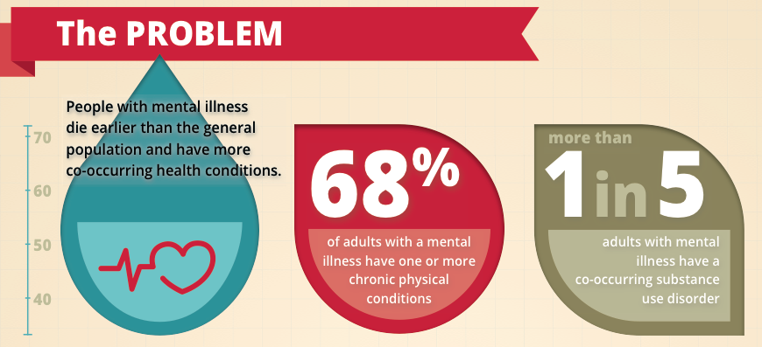
Behavioral Health Conditions
Impact Physical Health Conditions

Slide 35
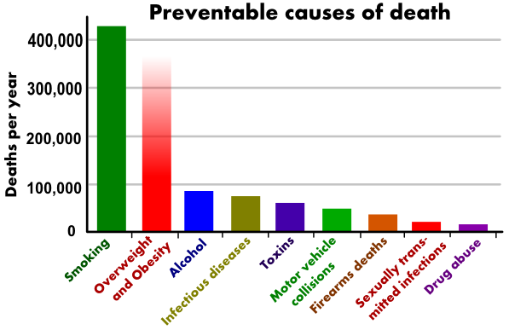
The Leading Actual Underlying Causes of Death
Smoking is the leading actual underlying cause of death in the U.S. U.

Slide 36
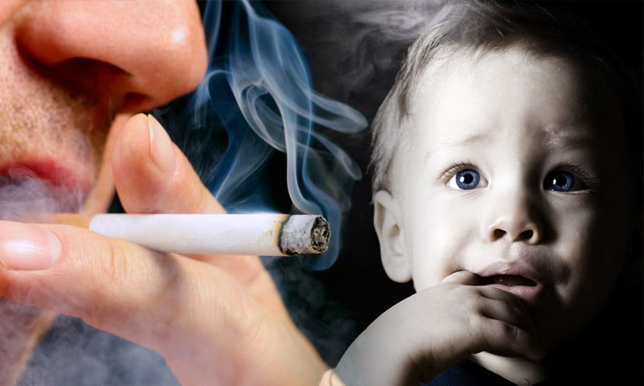
Impact of Tobacco

Slide 37
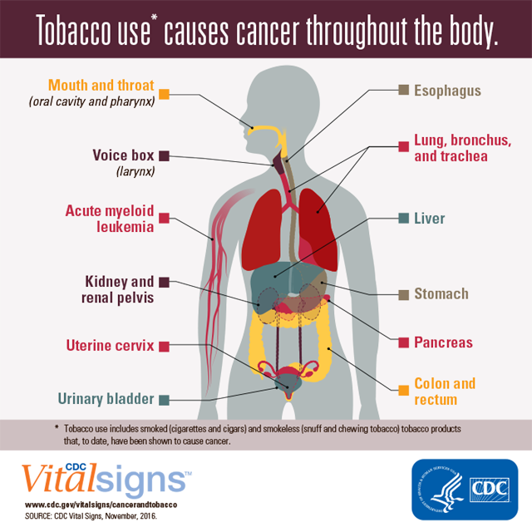

Slide 38
Adult Smoking Rates Harford County & Maryland, 2012-2016
Harford County rates worse than the State.
Source: CDC Maryland Behavioral Risk Factor Surveillance System (BRFSS)

Slide 39
Adolescent Tobacco Use Rates* Harford County & Maryland, 2010-2016
Source: Maryland Youth Risk Behavior Survey (YRBS)
Note: Students, Gr 9-12 who smoked at least 1 cigarette in the past 30 days
* Data gap between 2010-2013 and 2014-2016

Slide 40
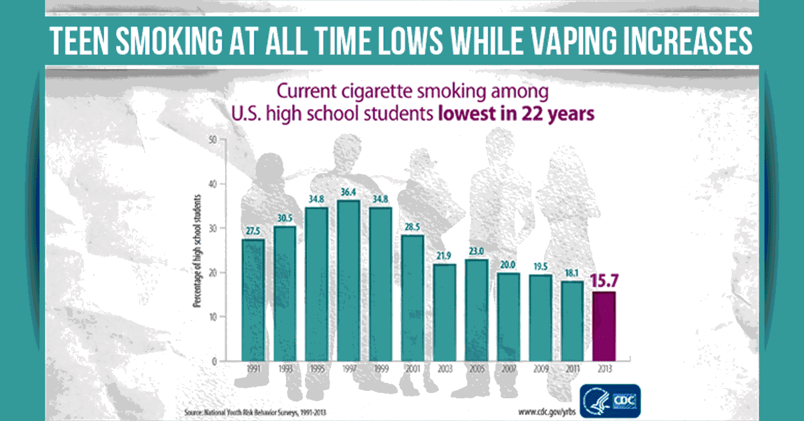

Slide 41
Cancer Mortality Rates Harford County & Maryland, 2013-2017
Harford County rates worse than the State.
* Age-Adjusted Rates
Source: Maryland Vital Statistics Reports

Slide 42
Cancer Incidence Rates by Type

Slide 43
Cancer Incidence Rates by Race

Slide 44
COPD Mortality Rates Harford County & Maryland, 2013-2017
Harford County rates worse than the State.
* Age-Adjusted Rates
Source: Maryland Vital Statistics Reports

Slide 45
Alzheimer’s Mortality Rates Harford County & Maryland, 2013-2017
Harford County rates have increased by 19% over past 5 years.
* Age-Adjusted Rates
Source: Maryland Vital Statistics Reports

Slide 46
Child Maltreatment Rates Harford County & Maryland, 2012-2016
Harford County rate exceeds the State average.
Source: Maryland DHR
http://ship.md.networkofcare.org/ph/ship

Slide 47
Domestic Violence Rates Harford County & Maryland, 2012-2016
Harford County rate now exceeds the State average.
Source: Maryland Uniform Crime Reporting Program
http://ship.md.networkofcare.org/ph/ship

Slide 48
Chlamydia Rates Harford County & Maryland, 2013-2017
* Age-Adjusted Rates
Source: Maryland Vital Statistics Reports

Slide 49
Gonorrhea Rates Harford County & Maryland, 2013-2017
282% increase over the past 5 years
* Age-Adjusted Rates
Source: Maryland Vital Statistics Reports

Slide 50
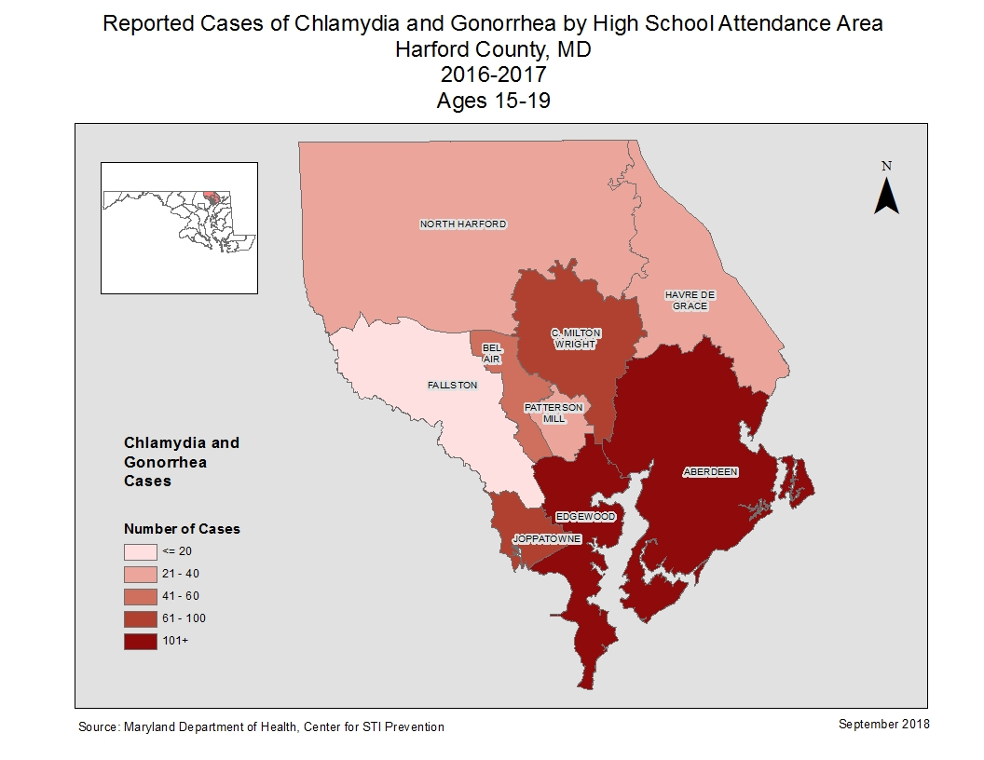
Chlamydia & Gonorrhea Cases by High School Attendance Area, Harford County, 2016-2017, Ages 15-19

Slide 51
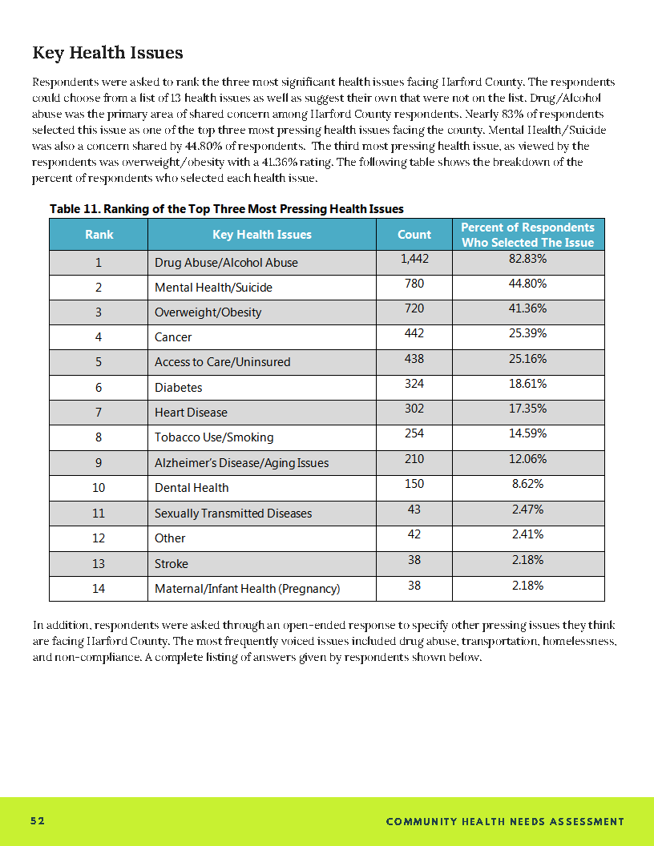
Most Pressing Health Issues

Slide 52
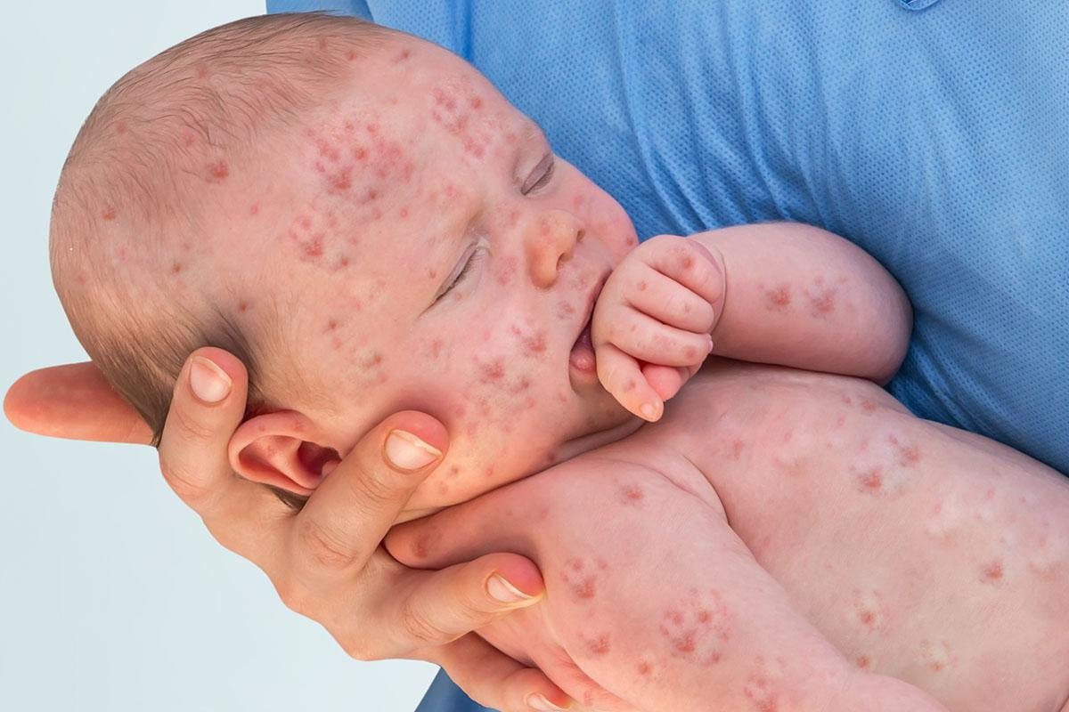
The Measles Epidemic

Slide 53
Vaccines Do Not Cause Autism.
Measles Do Cause Deaths.

Slide 54
Thank you!
410-838-1500
www.harfordcountyhealth.com

